Slide 1
Selection of non-linear features
(or, a gentle introduction to natural programming)

Slide 2
OUR NEW-OLD PROBLEM
How do you a priori ascertain the features important for your model?
High dimensionality
 | f1 | f2 | f3 | f4 | f5 |  |  |  |  |  |  |  |  |  |  |  | .. |  |  |  |  |  |  |  |  |  |  |  |  |  |  |  |  |  |  |  |  |  |  |  |  |  |  |  |  |  |  | fm
I1
I2
I3
I4
..
In

Slide 3
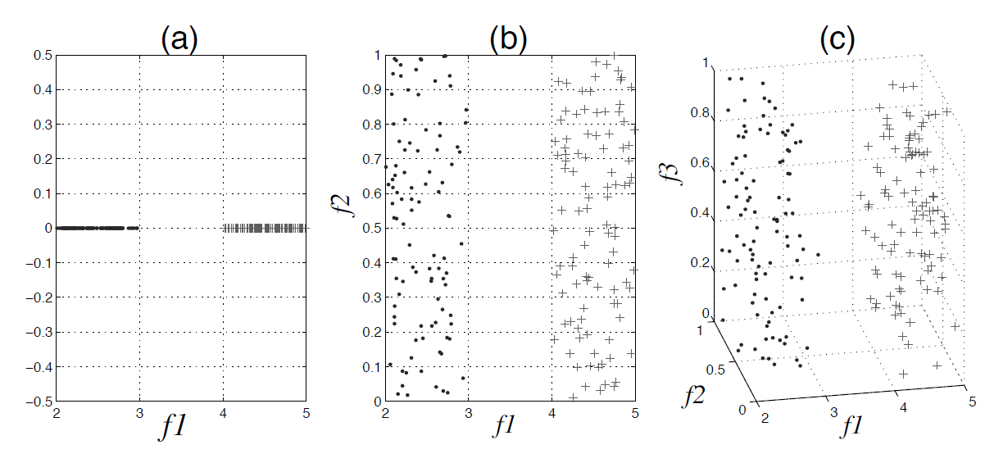
OUR NEW-OLD PROBLEM
Noise

Slide 4
Curse of dimensionality
As the quantity of features grows, patterns become less distinct, leading to a scenario where each data point possesses its own distinct characteristics.

Slide 5
Feature Selection vs feature Extraction
Feature extraction approach -> features are projected into a new space with lower dimensionality.
Principle Component Analysis (PCA),
Linear Discriminant Analysis (LDA)
Singular Value Decomposition (SVD)
…
Feature Selection approach -> Identify a small subset of features that minimize redundancy and maximize relevance to the target (i.e., class label). FS ascertains features that are capable of discriminating samples that belong to different classes
Information Gain
Relief
Chi Squares
Fisher Score
Lasso
…

Slide 6
Feature Selection vs feature Extraction
Feature extraction approach -> features are projected into a new space with lower dimensionality.
Principle Component Analysis (PCA),
Linear Discriminant Analysis (LDA)
Singular Value Decomposition (SVD)
…
Feature Selection approach -> Identify a small subset of features that minimize redundancy and maximize relevance to the target (i.e., class label). FS ascertains features that are capable of discriminating samples that belong to different classes
Information Gain
Relief
Chi Squares
Fisher Score
Lasso
…
Allows learning performance but interpretability of WHY the model Works is not so easy to identify
Allows better interpretability but pattern identification is constrained to the actual values of the ascertained features

Slide 7
Feature Selection
Selection strategies
Filter model -> independent of any classifier. They evaluate the relevance of a feature by studying its characteristics using certain statistical criteria. Feature evaluation could be either univariate (feature by feature) or multivariate (sets of features are tested at the same time). Any method that quantifies how good the feature(s) allow finding patterns.
Relief
Fisher score
CFS
FCBF

Slide 8
Feature Selection
Selection strategies
Wrapper model -> utilize a classifier as a selection criteria (WM depends on a given classifier). In other words, they select a set of features that has the most discriminative power using a given classifier, such as SVM and KNN. The wrapper model utilizes a clustering algorithm to evaluate the quality of selected features. It starts by (1) finding a subset of features. Then, (2) it evaluates the clustering quality using the selected subset. Finally, it repeats (1) and (2) until the desired quality is found. Evaluating all possible subsets of features is impossible in high-dimensional datasets. Therefore, heuristic search strategy is adopted to reduce the search space.
Any combination of a preferred search strategy and given classifier.

Slide 9
Feature Selection
Selection strategies
Hybrid model -> combines filter and wrapper features. It incorporates the statistical criteria, as the filter model does, to select several candidate features subsets with a given cardinality. Second, it chooses the subset with the highest classification accuracy. A typical hybrid process goes through the following steps: (1) it utilizes filtering criteria to select different candidate subsets. Then, (2) it evaluates the quality of model of each candidate subsets. Finally, (3) the subset with the highest model quality is selected. Compared to the wrapper model, the hybrid model is much more efficient
Embedded model -> performs feature selection in the learning time.

Slide 10
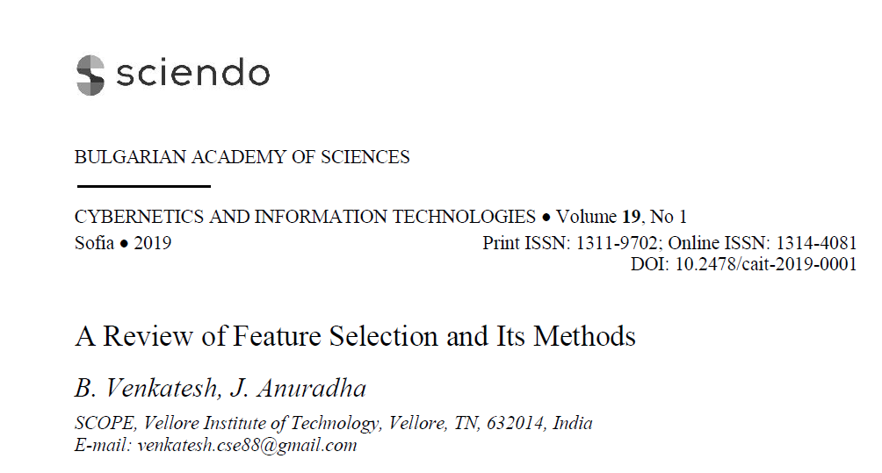
Feature Selection
Selection strategies
Embedded model -> performs feature selection in the learning time.
READ THE PAPER! QUESTION(S) IN THE PARTIAL EXAM WITHOUT ACCESS TO THE ARTICLE!

Slide 11
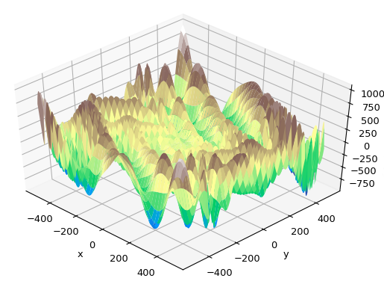
FOR A COMPLEX PROBLEM
UNKNOWN FUNCTION SHAPE
COMPLEX FUNCTIONS
NP-HARD PROBLEM

Slide 12
Our classical problem of optimization
No close solution

Slide 13
BE A GOOD BIOINFORMATICIAN
We meet at the ground floor.
We do some hard-core bioinformatics stuff.
We come back. We do some hard-core bioinformatics stuff.

Slide 14

BE A GOOD BIOINFORMATICIAN

Slide 15
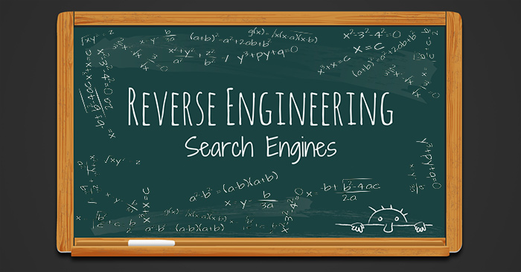
NATURAL COMPUTING

Slide 16
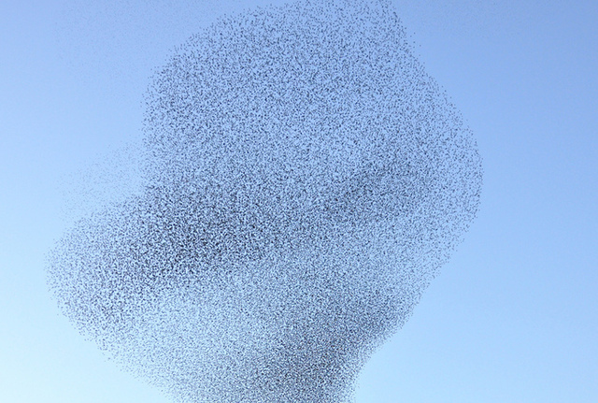
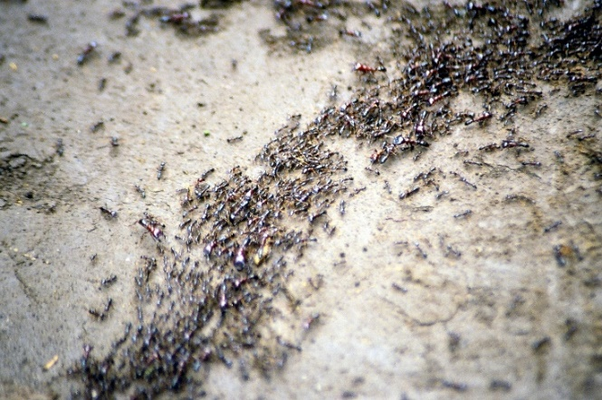
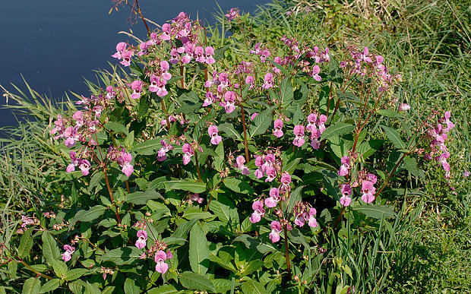
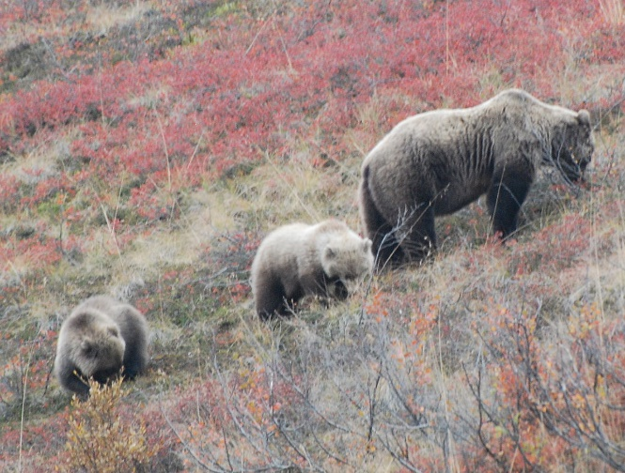
NATURAL SOLUTIONS
SWARMS
ANT COLONY
INVASIVE WEED
FORAGING

Slide 17
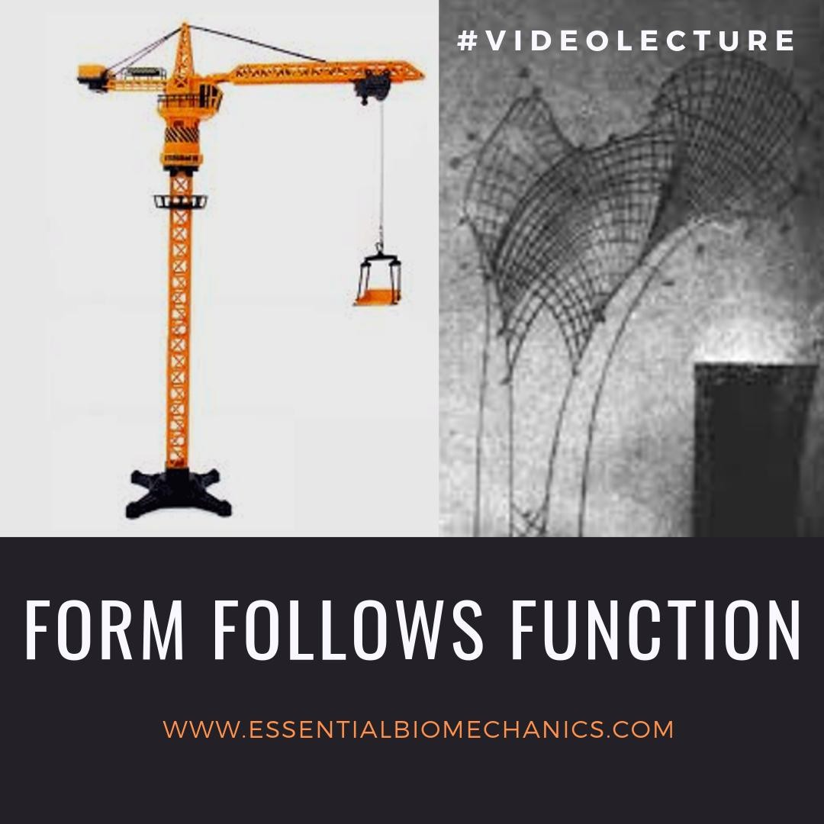
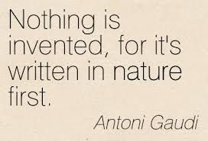
NATURE AS A WAY TO OPTIMIZE
Georg Hermann von Meyer
(1815-1892)

Slide 18
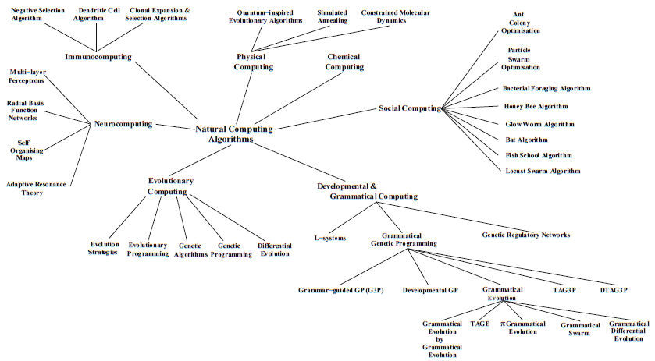
NATURE AS A WAY TO OPTIMIZE

Slide 19
NATURE AS A WAY TO OPTIMIZE

Slide 20

SOCIAL COMPUTING
Flocking behavior of birds
Behaviour of social insects
Notes:
The essence of these behaviours is that individuals can learn from both their own experience and from the experience of others. Hence a group can solve complex tasks which are beyond the capability if any of the individuals in the group. Crucially, this does not occur merely because the task is divided up amongst multiple individuals; rather it occurs because they can communicate with each other and thereby create a shared understanding of the problem. Even populations of individuals with limited information-processing abilities may be able to solve difficult problems, if the individuals communicate and cooperate.

Slide 21
NATURAL COMPUTING IN PRACTICE
Why do natural algorithms work?
Which are the components of our “search algorithm”?

Slide 22
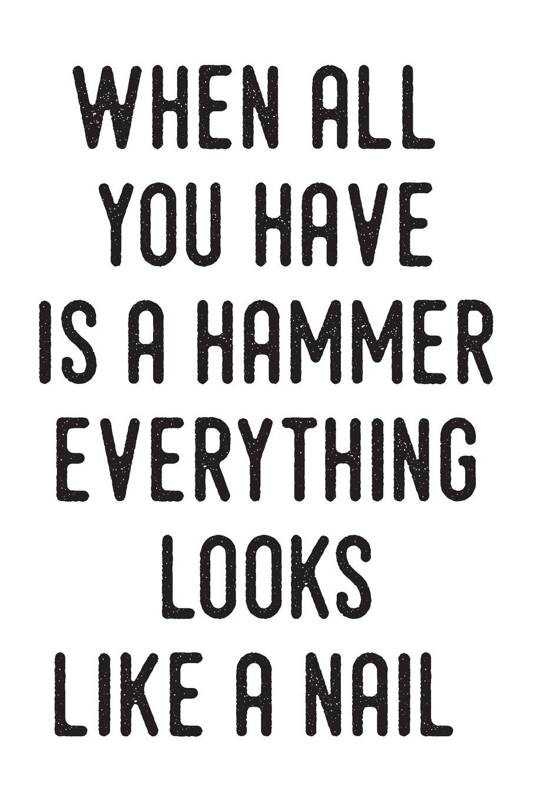

Slide 23
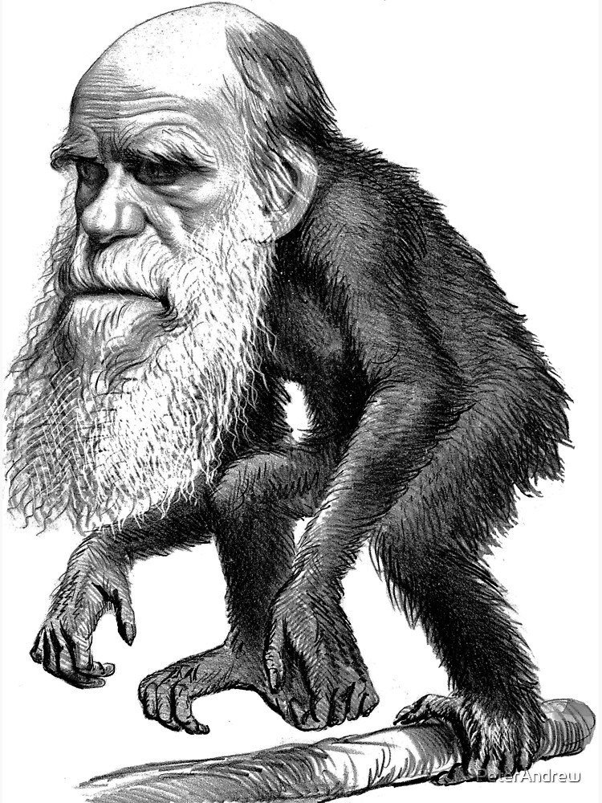
Evolutionary algorithms

Slide 24
EVOLUTIONARY ALGORITHMS
Population of answers
Select best answers
Next generation
Random mating
Recombination/Mutation

Slide 25
CLASSICAL GENETIC ALGORITHM

Slide 26
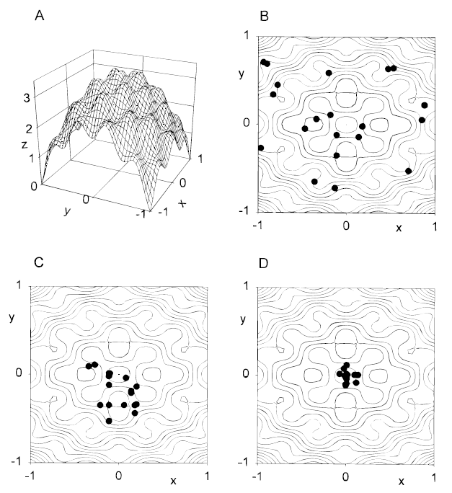
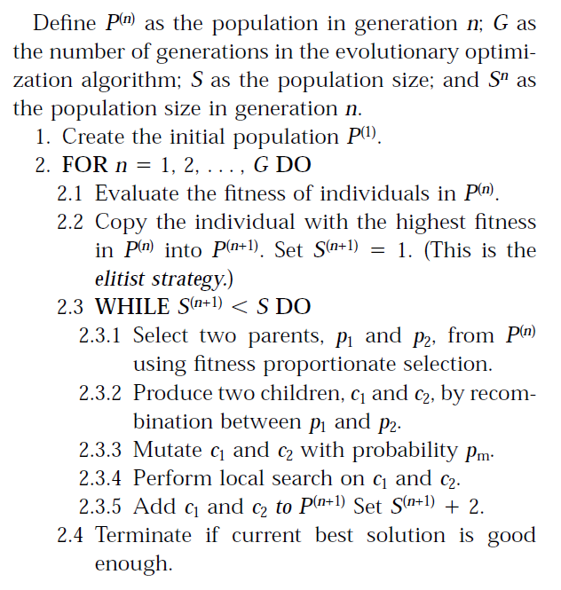
CLASSICAL GENETIC ALGORITHM

Slide 27
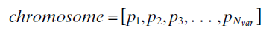
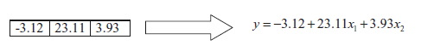
CLASSICAL GENETIC ALGORITHM
What do we need?
A chromosome based representation of the solution that we are searching for:

Slide 28
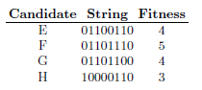
CLASSICAL GENETIC ALGORITHM
What do we need?
A chromosome based representation of the solution that we are searching for (coding and decoding):
Binary

Slide 29
CLASSICAL GENETIC ALGORITHM
What do we need?
A chromosome based representation of the solution that we are searching for (coding and decoding):
Binary
CODING TO BINARY by QUANTIZATION of a continuous variable

Slide 30
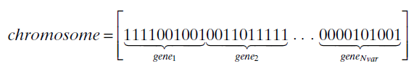
CLASSICAL GENETIC ALGORITHM
What do we need?
A chromosome based representation of the solution that we are searching for (coding and decoding):
Binary
CODING TO BINARY by QUANTIZATION of a continuous variable

Slide 31
CLASSICAL GENETIC ALGORITHM
What do we need?
A chromosome based representation of the solution that we are searching for (coding and decoding):
Binary
CODING TO BINARY by QUANTIZATION of a continuous variable

Slide 32
CLASSICAL GENETIC ALGORITHM
What do we need?
A chromosome based representation of the solution that we are searching for (coding and decoding):
Binary
DECODING FROM BINARY by QUANTIZATION of a continuous variable

Slide 33
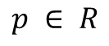
CLASSICAL GENETIC ALGORITHM
What do we need?
A chromosome based representation of the solution that we are searching for (coding and decoding):
Binary
Continuous
$$p ∈ R$$

Slide 34
CLASSICAL GENETIC ALGORITHM
What do we need?
A chromosome based representation of the solution that we are searching for (coding and decoding):
Binary
Continuous
Trees …
$$p ∈ R$$

Slide 35
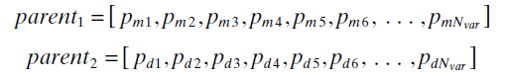
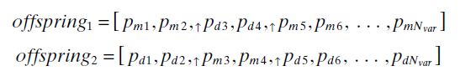
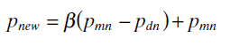
CLASSICAL GENETIC ALGORITHM
What do we need?
A way to generate new solutions by recombination from previous ones (Mating & Recombination):
By setting few crossover points
Binary
…
By setting random uniform crossovers
Continuous
Not allowing repeated values within each offspring
By mixing at each gene the proportions of the parents
Clustering based labeling

Slide 36
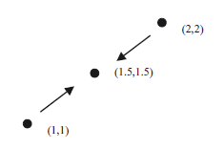
CLASSICAL GENETIC ALGORITHM
What do we need?
A way to generate new solutions by recombination from previous ones (Mating & Recombination):
Single crossover
Real valued genotypes

Slide 37
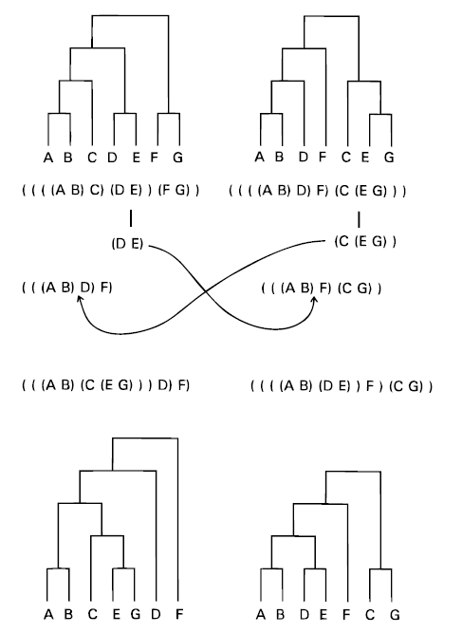
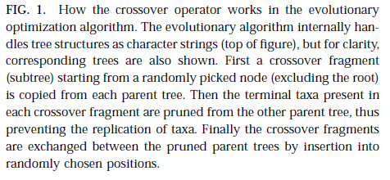
CLASSICAL GENETIC ALGORITHM
Genetic algorithm: crossover

Slide 38
CLASSICAL GENETIC ALGORITHM
How to introduce new solutions (mutation)?
f(px) ?
p2

Slide 39
CLASSICAL GENETIC ALGORITHM

Slide 40
CLASSICAL GENETIC ALGORITHM

Slide 41
CLASSICAL GENETIC ALGORITHM
HYPERPARAMETERS
How many?
Too high = time consuming. Slow convergence
Too small = noise will tend to predominate over selection
Population of answers
Which fitness?
Which elitism?
(too small = a lot of bad solutions
Too high = risk of ending in a local solution)
Select best answers
For how long?
Next generation
Random mating
How do I allow the best to mate?
At random?
Best have the higher frequency of mating?
Tournament selection?
Recombination/Mutation
Which mutation frequency?
Too small = result will tend to be local
Too high = random walking (no need
of doing a GA!)

Slide 42
CLASSICAL GENETIC ALGORITHM
HYPERPARAMETERS
Fitness
Dead penalty
Chromosome space
Objective function
No meaningful chromosome.
No way to go to one to the other!

Slide 43
CLASSICAL GENETIC ALGORITHM
Tournament selection. Pick a subset of individuals from the population. Ascertain the best one to reproduce in the next mating

Slide 44
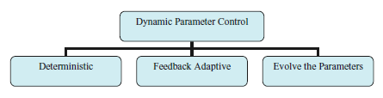
GENETIC ALGORITHM
HYPERPARAMETERS
Population of answers
Select best answers
Next generation
Random mating
Recombination/Mutation

Slide 45
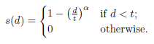
GENETIC ALGORITHM
EXTENSIONS
Dynamic environment (the fitness is not constant over time (i.e. financial markets))
restart of the learning process,
generation of more genotypic diversity if environmental change is detected,
maintenance of genotypic diversity during the GA run,
use of a memory mechanism to retain good past solutions (assumes cycling solutions), and use of multiple populations.
Diversity
Create population substructure (parallelization of populations evolving and exchanging migrants)
Weak selection pressure
Add more individuals
Consider only individuals of each class (fitness-sharing)

Slide 46
GENETIC ALGORITHM
EXTENSIONS
Island model
Spatial mating

Slide 47
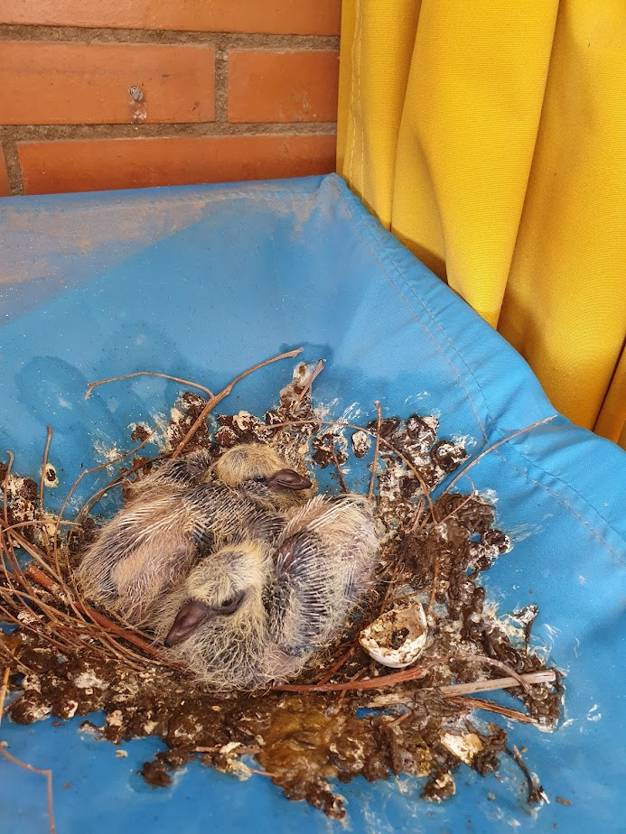
GENETIC ALGORITHM
MY OWN EXTENSION
SMALLER AND WEAK (for a Pigeon standard)
BIGGER, STRONGER, MORE AGGRESSIVE (for a Pigeon standard)
I kick the ass of my brother/sister because from a phenotypical point if view I am “better”
Notes:
To put it in other words

Slide 48
GENETIC ALGORITHM
EXTENSIONS
Can you propose an extension?

Slide 49
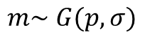
Evolution Strategies ((μ,λ)-ES)
EVOLUTIONARY ALGORITHMS
Mutation parameter μ
$$m\sim G(p,σ)$$
1/5 success rule
Self-adaptive mutation step
Single-Step-Size mutation
the ratio (denoted as φ) of successful mutations (ones which produce a
child of higher fitness than its parent) to the total number of mutations is
measured periodically during the optimisation run, with σ being altered as
necessary in order to approach a ratio of 1/5.

Slide 50
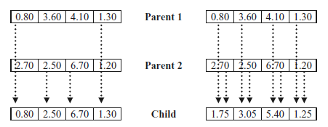
Evolution Strategies ((μ,λ)-ES)
EVOLUTIONARY ALGORITHMS
RECOMBINATION

Slide 51
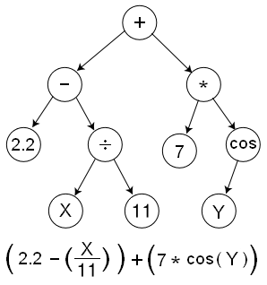
GENETIC PROGRAMMING
ASK THE COMPUTER TO LEARN THE FORMULA
Notes:
To put it in other words

Slide 52
GENETIC PROGRAMMING
ASK THE COMPUTER TO LEARN THE FORMULA
Notes:
To put it in other words

Slide 53
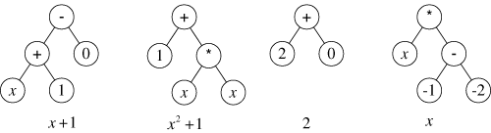
GENETIC PROGRAMMING
ASK THE COMPUTER TO LEARN THE FORMULA
Notes:
To put it in other words

Slide 54
GENETIC PROGRAMMING
ASK THE COMPUTER TO LEARN THE FORMULA
THE EFFECT OF RECOMBINATION
THE EFFECT OF MUTATION
Notes:
To put it in other words

Slide 55
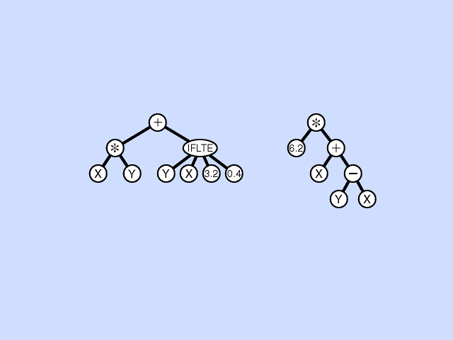
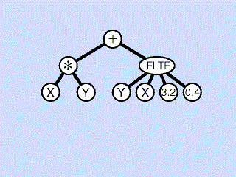
GENETIC PROGRAMMING
PROPOSED SOLUTION
RECOMBINATION
MUTATION
Notes:
To put it in other words

Slide 56
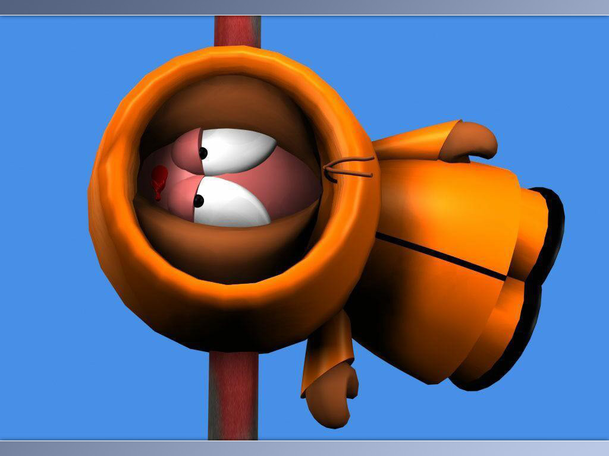
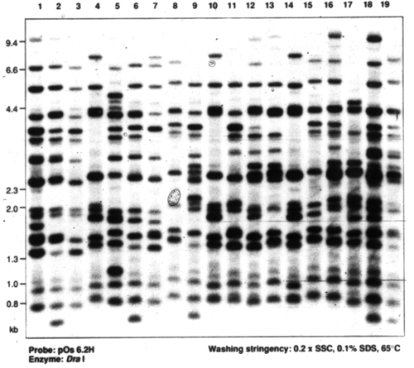

A real case problem
The crime

Slide 57
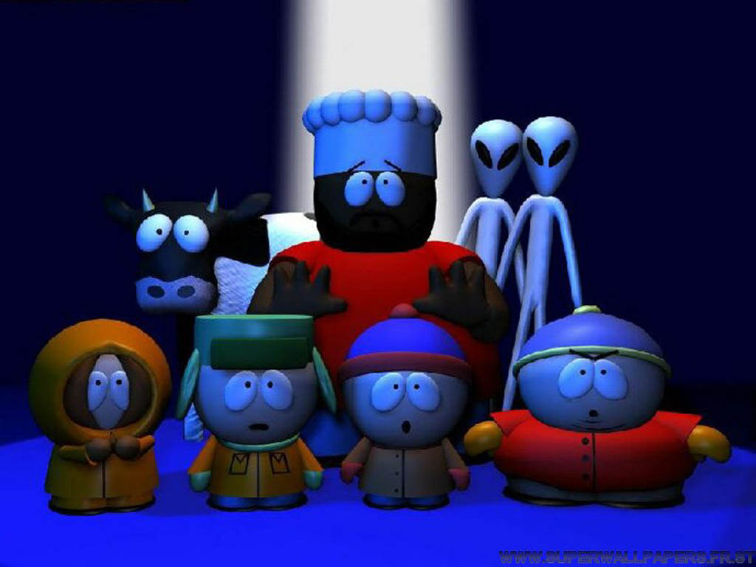

A real case problem

Slide 58
I had no other choice: he did not love me…

Slide 59
What happens if we do not have any suspect?

Slide 60
A real case problem
Ancestral origin?

Slide 61
Structure of the data
0<P(A|Pi)=pi<1
 | SNP1 | SNP2 | SNP3 | SNP4 | SNP5 | … | SNPm
P1
P2
P3
P4
…
…
Pn
Populations
m >>>> 1Million

Slide 62
The data
0<P(A|Pi)=pi<1
 | SNP1 | SNP2 | SNP3 | SNP4 | SNP5 | … | SNPm
P1
P2
P3
P4
…
…
Pn
Populations
m >>>> 1Million
In a degraded sample, we will have a lot of missing data.

Slide 63
What we need?
Genotyping a minimum number of SNPs that are “sensitive” for detecting genetic ancestry.

Slide 64
How to ascertain ASMs?
Fitness function: Informativeness of ancestry
Non-linear function
Entropy of the mean allelic distribution (that, is we assume that all the individuals are from the same population)
Mean entropy of the allelic distribution in all the populations
Am J Hum Genet. 2003 Dec;73(6):1402-22

Slide 65
The Genetic Algorithm
Population of answers
How would you code the GA in R?
Which Functions would you use?
How would you design the experiment to see if your approach worked out?
Select best answers
Next generation
Random mating
Recombination/Mutation

Slide 66

Social computing: particle swarms
Flocking behavior of birds
Foraging behaviour
Behaviour of social insects
Notes:
The essence of these behaviours is that individuals can learn from both their own experience and from the experience of others. Hence a group can solve complex tasks which are beyond the capability if any of the individuals in the group. Crucially, this does not occur merely because the task is divided up amongst multiple individuals; rather it occurs because they can communicate with each other and thereby create a shared understanding of the problem. Even populations of individuals with limited information-processing abilities may be able to solve difficult problems, if the individuals communicate and cooperate.

Slide 67
How does it work?
Sharing information allows to identify the optimal location
Each individual carries an amount of information different than others

Slide 68
How does it work?
What do we need to run it?
Position of each individual/particle
Velocity or gradient
pi = best solution found by particle i
gbest =best solution found so far by all the particles
At each iteration, a particle moves according to its previous velocity and gbest

Slide 69
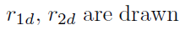
How does it work?
Current momentum
Best position so far found by the particle
Best position so far found by the population (social learning)

Slide 70
How does it work?
Current momentum
Best position so far found by the particle
Best position so far found by the population (social learning)

Slide 71
How does it work?

Slide 72
Fine tuning
Large changes in momentum from one iteration to another
Allows space exploration
Prevents focusing on interesting regions
Inertia or friction: Higher values allow for large jumps in space. Smaller values, to focus on the current space
Notes:
A common approach is to decrease the value of W gradually during the search process.

Slide 73
Fine tuning
Large changes in momentum from one iteration to another
Allows space exploration
Prevents focusing on interesting regions
Constriction coefficient
Notes:
A common approach is to decrease the value of W gradually during the search process.

Slide 74
Fine tuning
Scape from local optima
Predator-Prey PSO. Predators tend to go where there are more preys (which tend to move to gbest). This forces the preys to look for other places in addition to gbest.

Slide 75
Fine tuning
Scape from local optima
Predator-Prey PSO. Predators tend to go where there are more preys (which tend to move to gbest). This forces the preys to look for other places in addition to gbest.

Slide 76
Fine tuning
Particles that are closer in the solution space tend to repel each other
Scape from local optima
Charged Particle Swarm

Slide 77
Fine tuning
Scape from local optima
Multiple swarms
Similar to GA, they exchange migrants

Slide 78
Implement the swarm algorithm
Which functions shall we consider?

Slide 79
Ant colony
Special features
Stigmergic communication (change of the environment so other ants can get information out of it)
Direct interaction between ants (i.e. antennation)
Nonphysical communication between individuals (i.e. pheromones)

Slide 80
Food foraging
Maximize the difference between food gain and food search
Food is usually spatially organized
Pheromone trail that decays over time if path is not used

Slide 81
Food foraging
Maximize the difference between food gain and food search
Food is usually spatially organized

Slide 82
The problem must be transformed in a path in classical Ant Colony problem
Pheromone matrix history
(codifies for the memory of past learning)

Slide 83
The problem must be transformed in a path in classical Ant Colony problem
Pheromone matrix history
(codifies for the memory of past learning)

Slide 84
The problem must be transformed in a path in classical Ant Colony problem
Constructing protosolutions. At each step, which path the ant should take? In probability, take a path such:
Update the trail given the answers

